Slide 1


Scrap-Vend
TEAM MEMBERS
Mohammad Noman
Aishwarya Phulwani
Poornima Varshney
Saif Ali
Guided By
Miss. Rozy Verma

Slide 2

Table of Content
1
Introduction
2
Modules Divided
3
Layout Design
4
Database Architecture
5
References

Slide 3

Introduction
The main purpose of our web application is to ensure that all the scrap are managed in such a way that it protects both public health and environment by providing an ease to the people so that they can also contribute in the cleanliness of the surroundings without working hard and spending much time.
We provide the service to collect scrap material from your location and sell it to the recycling companies with market rates to help both.

Slide 4

MODULES DIVIDED
User
Login/Registration
Request/Cancel pickup
Edit profile
Contact us
Admin
Add/Remove items
Edit pricing scheme
Add/Remove pickup person
Schedule pickup
Add/Remove Company
Add Sales Information
Pickup Person
Pickup Status
Payment Mode

Slide 5

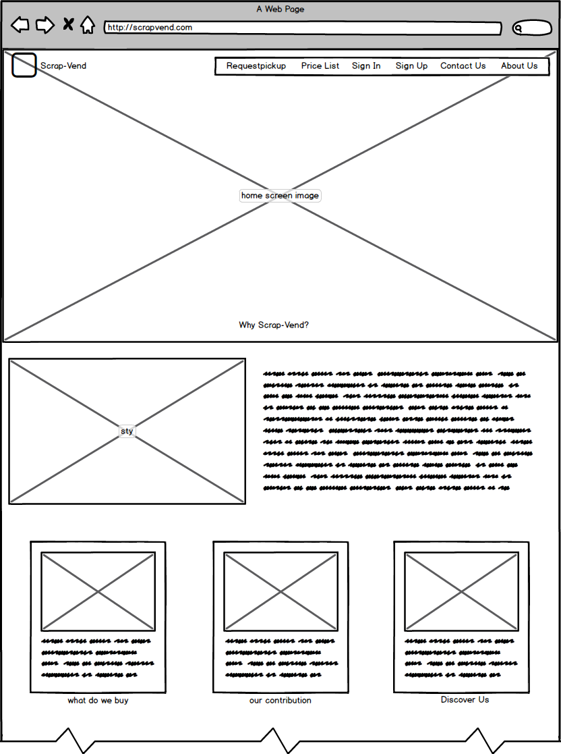
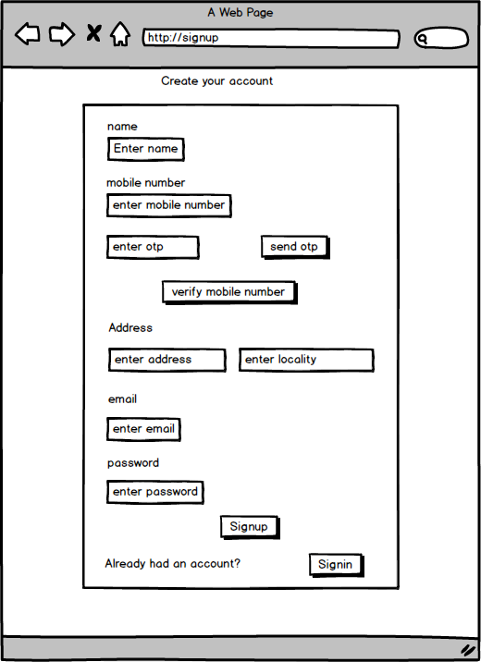
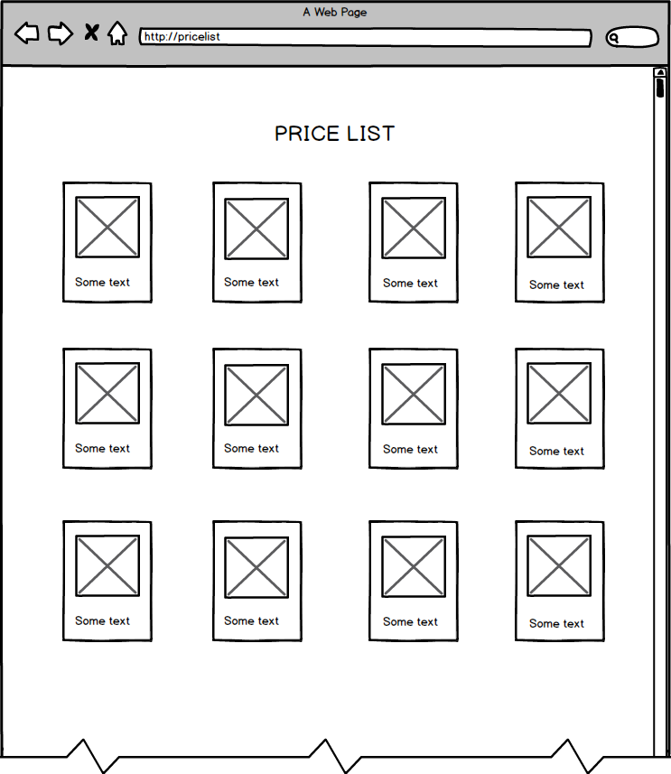
Layout Design
These are the wireframe of the web pages.
SIGN UP
HOME
PRICE-LIST

Slide 6
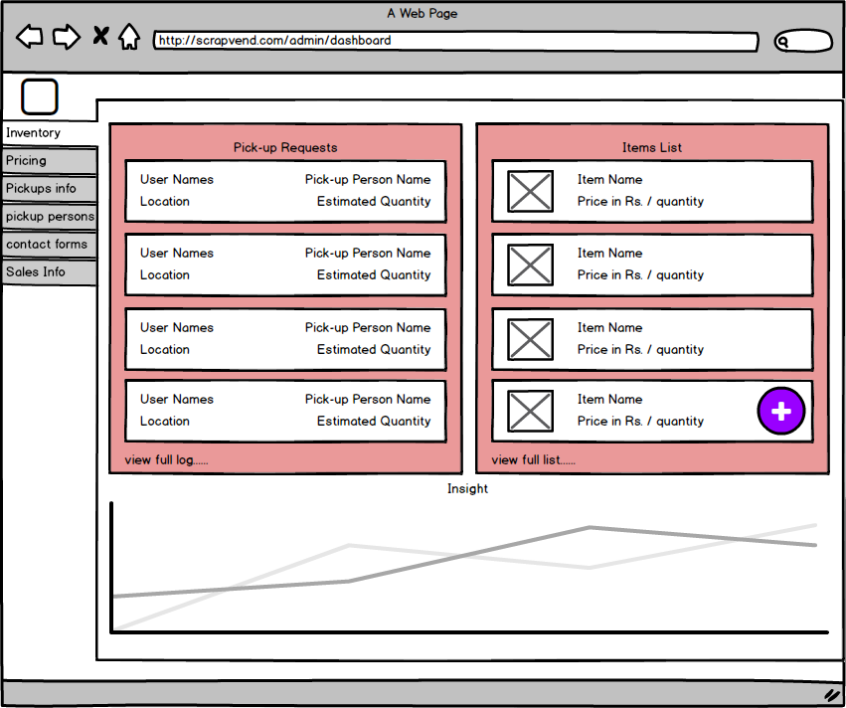
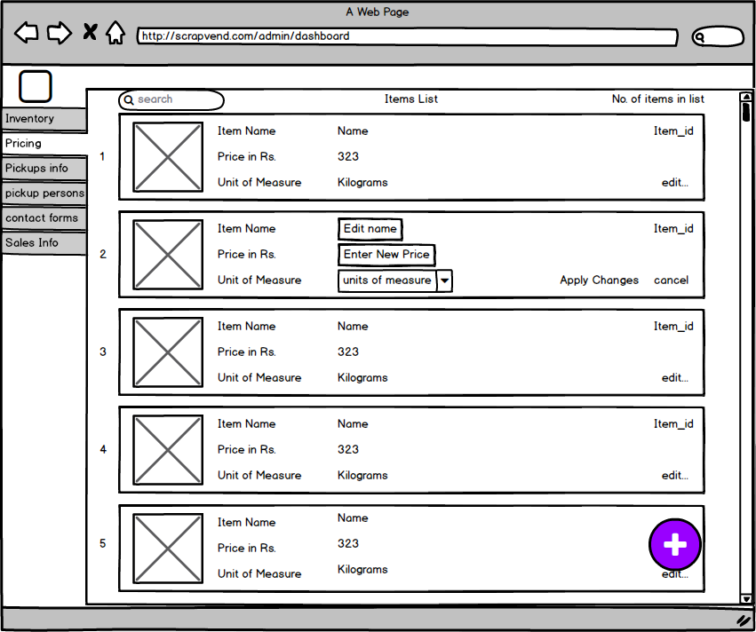
Pickup Person
Get a modern PowerPoint Presentation that is beautifully designed. Easy to change colors, photos and Text. You can simply impress your audience and add a unique zing and appeal to your Presentations. Get a modern PowerPoint Presentation that is beautifully designed. Easy to change colors, photos and Text. Get a modern PowerPoint Presentation that is beautifully designed.
Add/Edit Item
Admin Dashboard
Easy to change colors, photos and Text.
Easy to change colors, photos and Text.

Slide 7
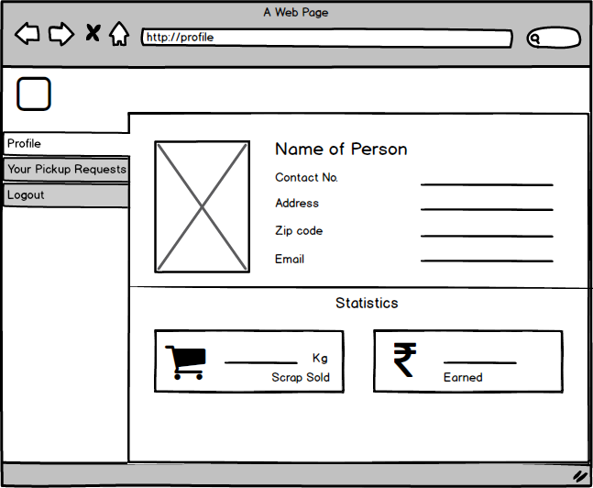
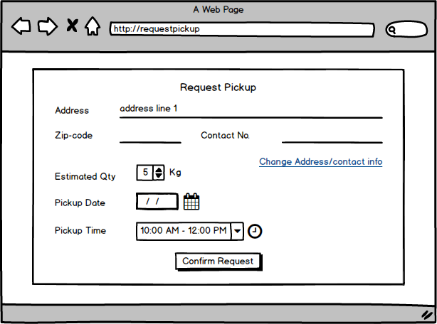
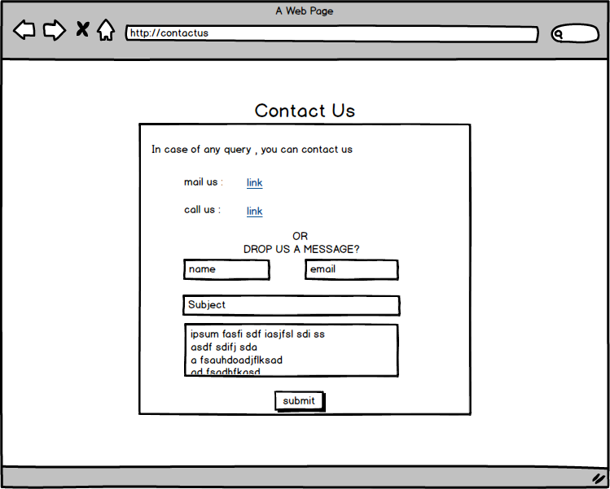
User
User Profile
Easy to change colors, photos and Text.
Get a modern PowerPoint Presentation that is beautifully designed. Easy to change colors, photos and Text. You can simply impress your audience and add a unique zing and appeal to your Presentations. Get a modern PowerPoint Presentation that is beautifully designed. Easy to change colors, photos and Text. Get a modern PowerPoint Presentation that is beautifully designed.
Request pickup
Easy to change colors, photos and Text.
Contact Us
Easy to change colors, photos and Text.

Slide 8
Admin
Get a modern PowerPoint Presentation that is beautifully designed. Easy to change colors, photos and Text. You can simply impress your audience and add a unique zing and appeal to your Presentations. Get a modern PowerPoint Presentation that is beautifully designed. Easy to change colors, photos and Text. Get a modern PowerPoint Presentation that is beautifully designed.
Add/Edit Item
Admin Dashboard
Admin can edit item related details or can add new item.
It displays all the item information and pickup persons information.

Slide 9
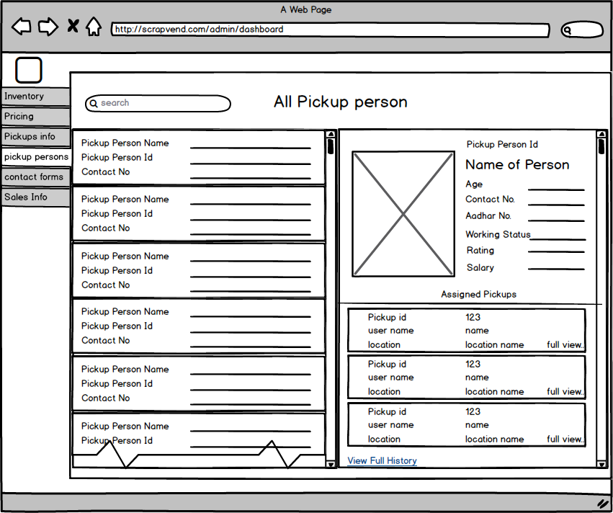
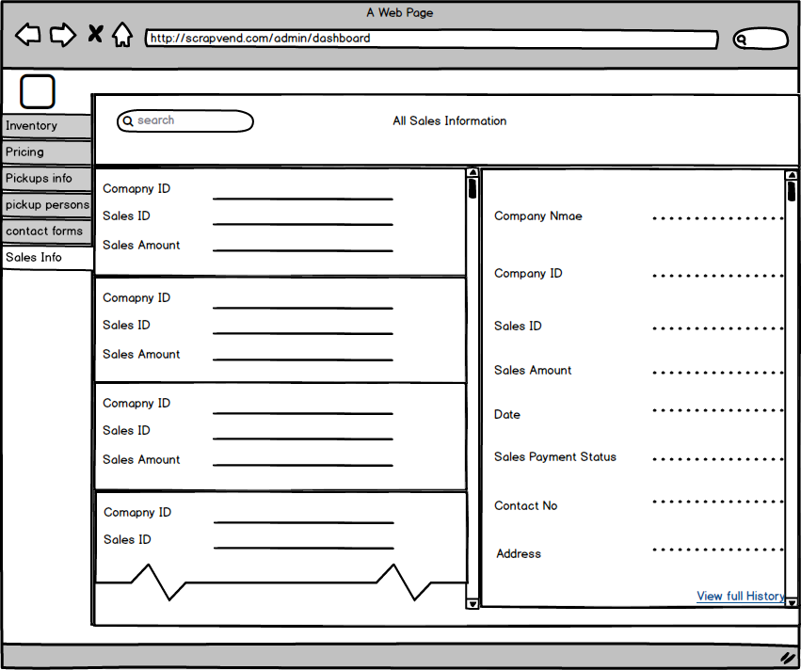
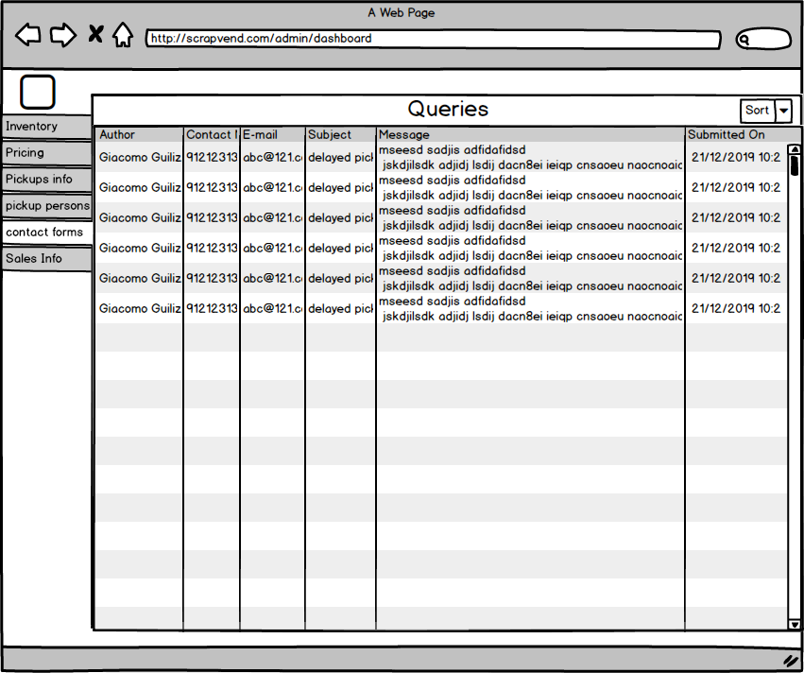
Admin
Pickup Person Info
This is the compete information of all the pickup persons.
Company Sales Info
Gives complete description of sales with other company.
Contact Requests
Admin can view all the contact requests.

Slide 10
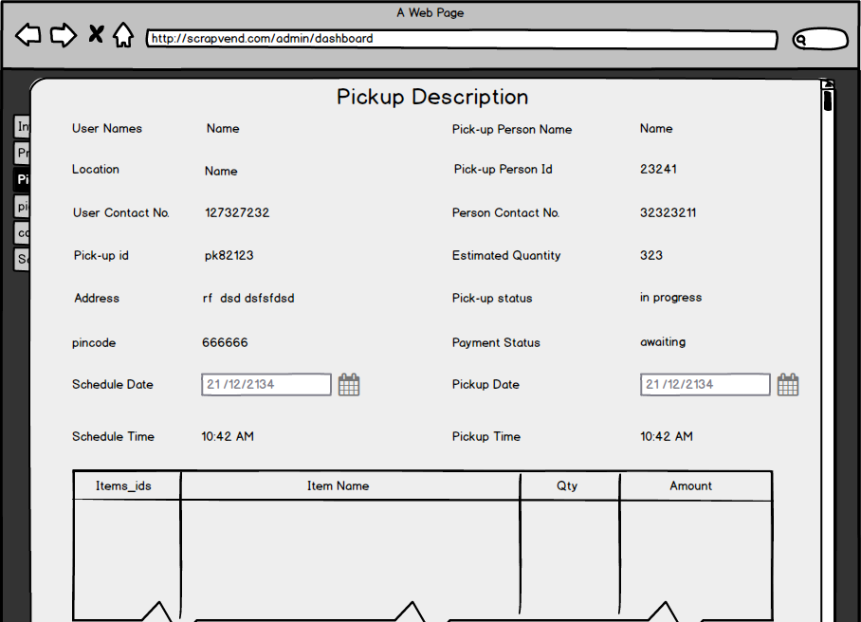
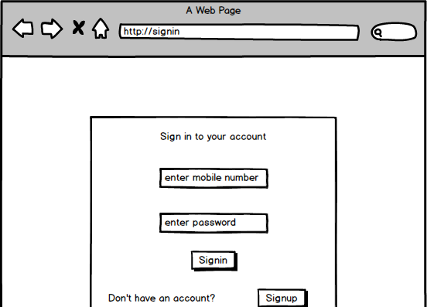
Admin
Pickup Description
Item List
Sign In
This is the complete description for a pickup request by any user.
This is a pricing list from where admin can view and change rate for any item or can add or delete items.
This page is common for User, Pickup Person and Admin. Their username role will redirect to desired page.

Slide 11

DATABASE

Slide 12
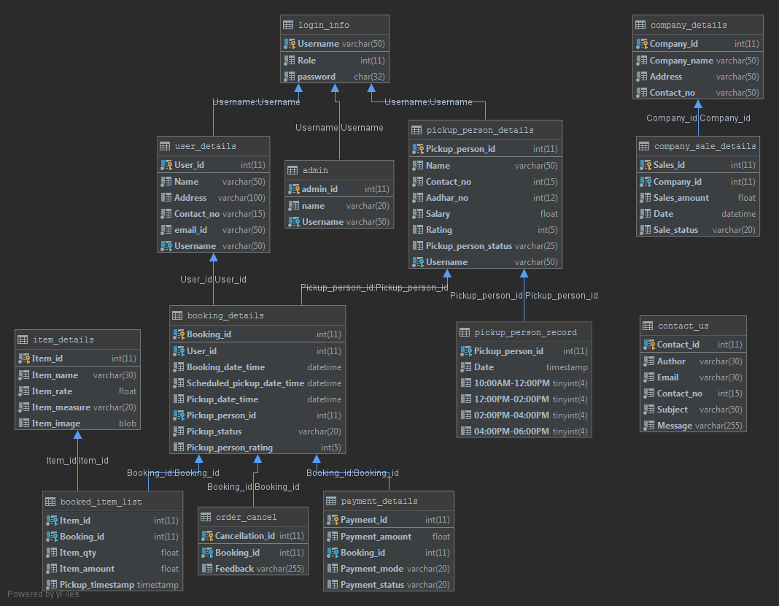
INSTRUCTIONS FOR USE
Open the presentation from the Google Slides Viewer or click the button below. You have to be signed in to your Google account.
Edit In Google Slides
Edit in PowerPoint
Please navigate to the File menu and select Make a copy.
You will get a copy of this document on your Google Drive and this copy will be created. So you will be able to edit, add or delete slides.
Navigate to the File menu and select Download as Microsoft PowerPoint.
You can download a .pptx file. So you can open and edit in PowerPoint.
More info on how to use this template at http://googleslidesppt.com/frequently-asked-questions/
All our templates are free to use under Creative Commons Attribution License. If you use the graphic assets (photos, images, icons, shapes and typographies) provided with this presentation you must keep the Credits slide.

Slide 13
References
[1] https://www.Dbdesigner.net (Last accessed on 31/03/2019)
[2] https://www.comentum.com/guide-to-web-application-development.html (Last accessed on 01/04/2019)
[3] https://www.geeksforgeeks.org/html-tutorials/ (Last accessed on 31/03/2019)
[4] https://www.geeksforgeeks.org/css-tutorials/ (Last accessed on 31/03/2019)
[5] https://www.w3schools.com/html/default.asp (Last accessed on 31/03/2019)
[6] https://www.w3schools.com/css/default.asp (Last accessed on 31/03/2019)

Slide 14
Thank you
Insert the title of your subtitle Here

